Slide 1
Local Government Rating System Review
Public Forums
August-October 2019

Slide 2
Local Government Rating System Review
[How Rates Work Video – available on the main page of www.engage.vic.gov.au/rating-review.]
Notes:
How Rates Work video.
[Not uploaded to website as file size too large. However, the video is available at the top of the main page of the Rating Review website, www.engage.vic.gov.au/rating-review.]

Slide 3
Local Government Rating System Review
Panel Members
Dr Kathy Alexander (Chair)
Mr John Tanner AM
Dr Ron Ben-David
Must report to the Minister for Local Government by 31 March 2020

Slide 4
Local Government Rating System Review
Equity and fairness in rating
Notes:
Rates are largest revenue source for local government, impacting on all Victorians.
The review will look at the system through the lens of equity and fairness. What do these themes mean to you?
The review will look at:
current local government rates and charges levied under the Local Government Act 1989, and a number of other State laws (including rates made under the Cultural and Recreational Lands Act 1963 & the Electricity Industry Act 2000)
the rating system’s interaction with the State’s taxation/valuation systems;
current rating exemptions and concessions;
the autonomy of local governments to apply the rating system to meet local needs;
current exemptions and discounts for rates and their application to various classes of land
the impacts any recommended changes would have on councils, businesses and various classes of ratepayers.
The only part of the rating system out of scope is the rate cap mechanism which will be separately reviewed by December 2021.

Slide 5
Local Government Rating System Review
3-month consultation
Video
Quick online survey
Written submissions for public and councils
Public forums around Victoria
Parallel meetings with Mayors, councillors and council CEOs
Your feedback today is welcomed on key themes and other issues

Slide 6
Local Government Rating System Review
Source: Auditor General
Notes:
More than half of local government revenue comes from rates, with about 16 per cent from Federal and State government grants.
User fees, fines and developer contributions make up most of the remaining revenue pie.
Rural and regional councils receive higher levels of grants.

Slide 7
Local Government Rating System Review
Q. Should rates be determined by property values?
Issue: The relationship between property values and rates

Slide 8
Local Government Rating System Review
Q. Should all property owners pay rates?
Issue: Rate exemptions and waivers
Notes:
Rating exemptions are currently set in the Act and can also be offered by Councils themselves through waivers.
Exemptions under s.154 of the Act include:
State and Commonwealth land (Crown Land), where it is either unoccupied or it is used exclusively for public or municipal purposes;
Crown land leased to a rail transport operator;
Land used exclusively for charitable purposes;
Land used as a residence of ministers of religion;
Mines;
Returned Services League (RSL) clubs.

Slide 9
Local Government Rating System Review
Source: Valuer-General Victoria

Slide 10
Local Government Rating System Review
Q. Should some properties and ratepayers pay different rates than others?
Issues: Differential rates, special rating arrangements, discounts
Notes:
The Act allows councils to levy different rates for different properties.
Differential rates are in widespread use by councils. They are often used to provide a discount or increased rates for different property types. Common differential rates in use are those for farm land, commercial and industrial land and vacant land.

Slide 11
Local Government Rating System Review
Table 1. Example of differential rates
Category | Property value | Rate in the Dollar | Rates Payable
Residential Land | $600,000 | 0.00250 | $1,500
Commercial Land | $600,000 | 0.00500 | $3,000
Farm Land | $600,000 | 0.00125 | $750
Notes:
Differential rates allow a council to set different rates in the dollar for different property types.
The basic example here shows how three different properties, all valued the same amount, can pay different amounts in rates.

Slide 12
Local Government Rating System Review
Table 2: Count of council differential rates – 2019-20
Number of differentials | 1 (uniform) | 2 | 3 | 4 | 5 | 6+
Number of councils | 13 | 5 | 6 | 13 | 16 | 26
Source: DELWP, Council adopted budgets 2019-20

Slide 13
Local Government Rating System Review
Source: Local government budgets 2013-14 to 2019-20
Notes:
Over the last six years, interface councils have consistently given farm properties discounts between 25-30 per cent (compared to residential properties).
On average, small and large shires have provided around a 15 per cent rate discount for farms (compared to residential properties), with this amount rising in the past 2 years in small shires.
The largest discount to farm properties is historically provided in metro areas, but only by a few councils. This discount has reduced in 2019-20.

Slide 14
Local Government Rating System Review

Slide 15
Local Government Rating System Review
Cultural/recreational land
Ovals, sporting clubs, racecourses, showgrounds
In practice pay much lower rates
Power generators
Pay rates based on power generation capacity, not land value
Notes:
We now turn to some rather specialist rating practices that affect all councils.
Land designated for ‘cultural and recreational purposes’ is subject to rates, but the rates are not based on the land value. Rather, councils have discretion to decide a “reasonable” amount of rates, having regard to council services provided and the community benefits from that property.
Some councils have extensive policies and approaches to this form of rating, while others do not.
Such lands include a range of property types from small sporting clubs to large commercial facilities.
Electricity generators can opt-in to a scheme to pay rates under a different scheme; based on the power output of the generator, not the value of the property.

Slide 16
Local Government Rating System Review
Waivers, concessions and financial hardship
What criteria should apply to councils providing waivers and concessions?
Notes:
Pensioners currently receive a concession on rates funded by the State Government of up to $235 this year.
Some councils provided additional discounts to pensioners.

Slide 17
Local Government Rating System Review
Q. How easy is it to understand rates notices and make payments?
Issue: the ratepayer experience of rates and council interaction

Slide 18
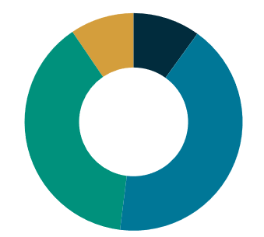
Local Government Rating System Review
Figure 5: “Which of the following best describes how your council's rates are set?”
Easy to understand
Somewhat easy to understand
Complicated
I have not really looked into it
Source: Engage Victoria, 23 October 2019
Notes:
This is a question from the quick survey on our Engage Vic page.
Most common responses:
42 per cent of respondents said “Somewhat easy to understand”
40 per cent of respondents said “Complicated”

Slide 19
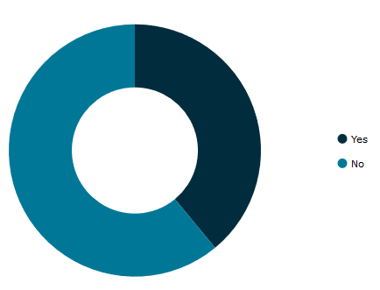
Local Government Rating System Review
Figure 6: “Have you ever given feedback to your council on rates?”
Source: Engage Victoria, 23 October 2019
Notes:
This is another question from the quick survey on our Engage Vic page.
40 per cent of respondents said Yes
60 per cent said No
The Panel is interested in hearing about how the community engages in the rate-setting process?

Slide 20
Local Government Rating System Review
What else?

Slide 21
Local Government Rating System Review
https://engage.vic.gov.au/rating-review
P. 03 9948 8533
rating.review@delwp.vic.gov.au

